Slide 1
PageRank
Data Structures
1st Semester, 2015

Slide 2
Contents
PageRank
Introduction
Basic Idea
Random Surfer Model
Adjacency Matrix Implementation
Adjacency Matrix
Transition Probability Matrix
Vector-Matrix Multiplication
Inverse-Adjacency List Implementation
Motivation
Inverse Adjacency Lists
PageRank Calculation with IAL

Slide 3


Application

Slide 4





Real Example
9/10
8/10
7/10
7/10
5/10

Slide 5
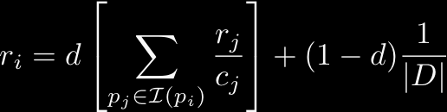

Overview
r_{i}: pagerank of page at i_{th} iteration
I(p_{i}): set of pages
d: damping factor
|D|: total number of pages
c_{j}: number of outbound links on p_{j}
PageRank
0.4
0.2
0.17
0.13
0.06
0.04

Slide 6
PageRank: Key Idea
Hyperlink
PageRank
0.4
0.2
0.17
0.13
0.06
0.04

Slide 7
PageRank: Basic Idea (1/3)

Slide 8
PageRank: Basic Idea (2/3)

Slide 9
PageRank: Basic Idea (3/3)

Slide 10


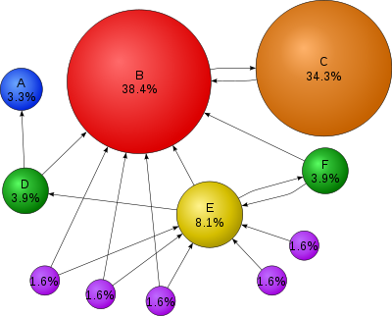
PageRank: Random Surfer Model
Probability of following links
Probability of random jump

Slide 11


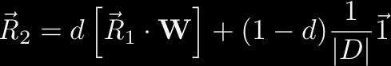

Power Iteration
……

Slide 12

PageRank: Review
www.wikipedia.org

Slide 13
Objectives
To understand the PageRank algorithm
To implement the algorithm using adjacency matrix and inverse adjacency lists

Slide 14
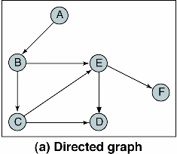
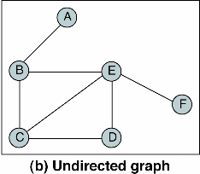
Review of Graph
Graph?
collection of nodes called vertices, and line segments called edges that connect pairs of nodes
Type of Graph
Directed graph
Undirected graph

Slide 15
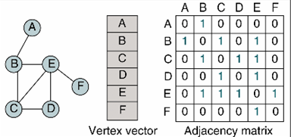
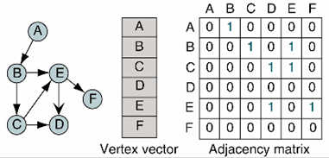
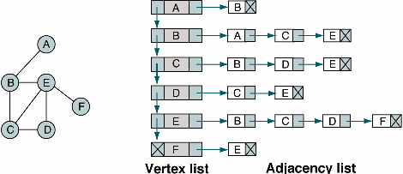
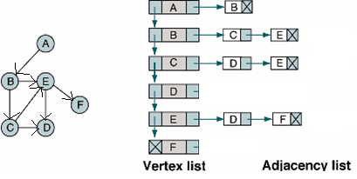
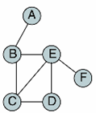
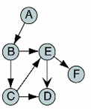
Review of Graph
Graph Structures
Adjacency Matrix
Adjacency List
nondirected graph
directed graph
nondirected graph
directed graph

Slide 16
Contents (Revisited)
PageRank
Introduction
Basic Idea
Random Surfer Model
Adjacency Matrix Implementation
Adjacency Matrix
Transition Probability Matrix
Vector-Matrix Multiplication
Inverse-Adjacency List Implementation
Motivation
Inverse Adjacency Lists
PageRank Calculation with IAL

Slide 17
Mini Project #2
Dataset
wikipedia (adj_matrix, inv_adj_list) (11 web pages)
movie (node, adj_matrix, adj_list, inv_adj_list) (5757 web pages)
Source code
pagerank_matrix.c
pagerank_list.c
Implementation
2 functions in pagerank_matrix.c
1 functions in pagerank_list.c
Report
Functions
Running time
Output files

Slide 18
pagerank_matrix.c
int main(int argc, char *argv[])
{
char* inputFile = argv[1];
int numPages = atoi(argv[2]);
double d = atof(argv[3]);
int numIteration = atoi(argv[4]);
double* vector = allocateVector(numPages, 1.0/numPages);
double** matrix = allocateMatrix(numPages, 0.0);
loadAdjacencyMatrix(inputFile, matrix);
generateTPMatrix(matrix, numPages);
vector = calculatePageRank(vector, matrix, numPages, d, numIteration);
return 0;
}

Slide 19
Adjacency Matrix
0 1 2 3 4 5 6 7 8 9 10
0 0 0 0 0 0 0 0 0 0 0 0
1 0 0 1 0 0 0 0 0 0 0 0
2 0 1 0 0 0 0 0 0 0 0 0
3 1 1 0 0 0 0 0 0 0 0 0
4 0 1 0 1 0 1 0 0 0 0 0
5 0 1 0 0 1 0 0 0 0 0 0
6 0 1 0 0 1 0 0 0 0 0 0
7 0 1 0 0 1 0 0 0 0 0 0
8 0 1 0 0 1 0 0 0 0 0 0
9 0 0 0 0 1 0 0 0 0 0 0
10 0 0 0 0 1 0 0 0 0 0 0
1
2
5
0
4
10
3
9
6
7
8
If page i points to page j, then M[i][j] = 1
If page i does not point to page j, then M[i][j] = 0

Slide 20
Transition Probability Matrix
0 1 2 3 4 5 6 7 8 9 10
0 0 0 0 0 0 0 0 0 0 0 0
1 0 0 1 0 0 0 0 0 0 0 0
2 0 1 0 0 0 0 0 0 0 0 0
3 1 1 0 0 0 0 0 0 0 0 0
4 0 1 0 1 0 1 0 0 0 0 0
5 0 1 0 0 1 0 0 0 0 0 0
6 0 1 0 0 1 0 0 0 0 0 0
7 0 1 0 0 1 0 0 0 0 0 0
8 0 1 0 0 1 0 0 0 0 0 0
9 0 0 0 0 1 0 0 0 0 0 0
10 0 0 0 0 1 0 0 0 0 0 0
1
2
5
0
4
10
3
9
6
7
8
W[i][j] is the transition probability from page i to page j by following link

Slide 21
Transition Probability Matrix
0 1 2 3 4 5 6 7 8 9 10
0 0 0 0 0 0 0 0 0 0 0 0
1 0 0 1/1 0 0 0 0 0 0 0 0
2 0 1/1 0 0 0 0 0 0 0 0 0
3 1/2 1/2 0 0 0 0 0 0 0 0 0
4 0 1/3 0 1/3 0 1/3 0 0 0 0 0
5 0 1/2 0 0 1/2 0 0 0 0 0 0
6 0 1/2 0 0 1/2 0 0 0 0 0 0
7 0 1/2 0 0 1/2 0 0 0 0 0 0
8 0 1/2 0 0 1/2 0 0 0 0 0 0
9 0 0 0 0 1/1 0 0 0 0 0 0
10 0 0 0 0 1/1 0 0 0 0 0 0
1
2
5
0
4
10
3
9
6
7
8
W[i][j] is the transition probability from page i to page j by following link

Slide 22
Handling Pages with No Outlinks
0 1 2 3 4 5 6 7 8 9 10
0 0 0 0 0 0 0 0 0 0 0 0
1 0 0 1/1 0 0 0 0 0 0 0 0
2 0 1/1 0 0 0 0 0 0 0 0 0
3 1/2 1/2 0 0 0 0 0 0 0 0 0
4 0 1/3 0 1/3 0 1/3 0 0 0 0 0
5 0 1/2 0 0 1/2 0 0 0 0 0 0
6 0 1/2 0 0 1/2 0 0 0 0 0 0
7 0 1/2 0 0 1/2 0 0 0 0 0 0
8 0 1/2 0 0 1/2 0 0 0 0 0 0
9 0 0 0 0 1/1 0 0 0 0 0 0
10 0 0 0 0 1/1 0 0 0 0 0 0
1
2
5
0
4
10
3
9
6
7
8
W[i][j] is the transition probability from page i to page j by following link
If a page i has no outlinks, then generate ‘virtual’ outlinks to every page

Slide 23
Handling Pages with No Outlinks
0 1 2 3 4 5 6 7 8 9 10
0 1/11 1/11 1/11 … 1/11
1 0 0 1/1 0 0 0 0 0 0 0 0
2 0 1/1 0 0 0 0 0 0 0 0 0
3 1/2 1/2 0 0 0 0 0 0 0 0 0
4 0 1/3 0 1/3 0 1/3 0 0 0 0 0
5 0 1/2 0 0 1/2 0 0 0 0 0 0
6 0 1/2 0 0 1/2 0 0 0 0 0 0
7 0 1/2 0 0 1/2 0 0 0 0 0 0
8 0 1/2 0 0 1/2 0 0 0 0 0 0
9 0 0 0 0 1/1 0 0 0 0 0 0
10 0 0 0 0 1/1 0 0 0 0 0 0
1
2
5
0
4
10
3
9
6
7
8
W[i][j] is the transition probability from page i to page j by following link
If a page i has no outlinks, then generate ‘virtual’ outlinks to every page

Slide 24
Vector-Matrix Multiplication
0 1 2 3 4 5 6 7 8 9 10
1 1 1 1 1 1 1 1 1 1 1
0 1 2 3 4 5 6 7 8 9 10
0 1/11 1/11 1/11 … 1/11
1 0 0 1/1 0 0 0 0 0 0 0 0
2 0 1/1 0 0 0 0 0 0 0 0 0
3 1/2 1/2 0 0 0 0 0 0 0 0 0
4 0 1/3 0 1/3 0 1/3 0 0 0 0 0
5 0 1/2 0 0 1/2 0 0 0 0 0 0
6 0 1/2 0 0 1/2 0 0 0 0 0 0
7 0 1/2 0 0 1/2 0 0 0 0 0 0
8 0 1/2 0 0 1/2 0 0 0 0 0 0
9 0 0 0 0 1/1 0 0 0 0 0 0
10 0 0 0 0 1/1 0 0 0 0 0 0
0 1 2 3 4 5 6 7 8 9 10
.6
3.9
… …
1
2
5
0
4
10
3
9
6
7
8

Slide 25
Other operation
d *
0 1 2 3 4 5 6 7 8 9 10
.6
3.9
…
1
2
5
0
4
10
3
9
6
7
8

Slide 26
Other operation
d *
0 1 2 3 4 5 6 7 8 9 10
+ ( 1 – d ) * 1/|D|
.6
3.9
…
1
2
5
0
4
10
3
9
6
7
8

Slide 27
Matrix Implementation: Summary
Load the adjacency matrix
Generate the transition probability matrix
Handling pages with no outlinks
Power Iteration
Vector-matrix multiplication
Vector-vector addition

Slide 28
pagerank_matrix.c
int main(int argc, char *argv[])
{
char* inputFile = argv[1];
int numPages = atoi(argv[2]);
double d = atof(argv[3]);
int numIteration = atoi(argv[4]);
double* vector = allocateVector(numPages, 1.0/numPages);
double** matrix = allocateMatrix(numPages, 0.0);
loadAdjacencyMatrix(inputFile, matrix);
generateTPMatrix(matrix, numPages);
vector = calculatePageRank(vector, matrix, numPages, d, numIteration);
return 0;
}

Slide 29
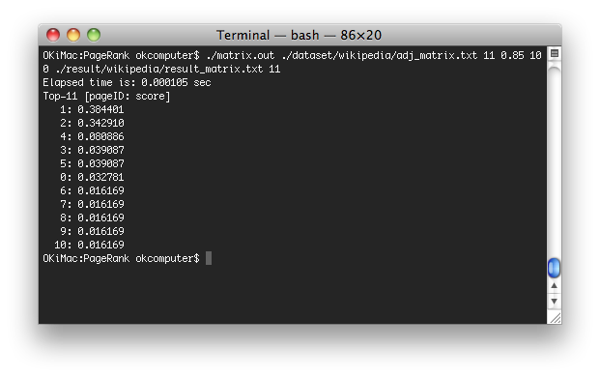
pagerank_matrix.c: Screen Shot
[Input_file] [#_of_node] [damping_factor] [#_of_iteration] [output_file] [Top_K]

Slide 30
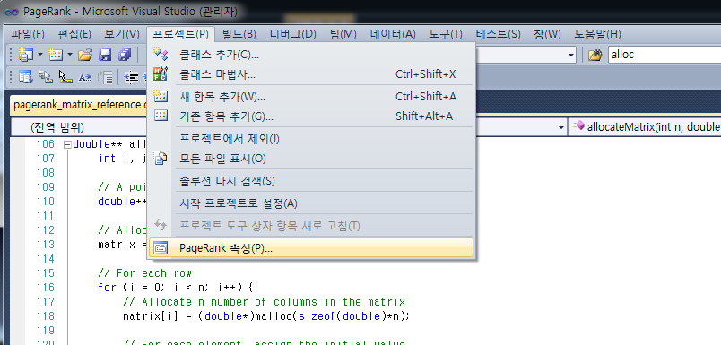
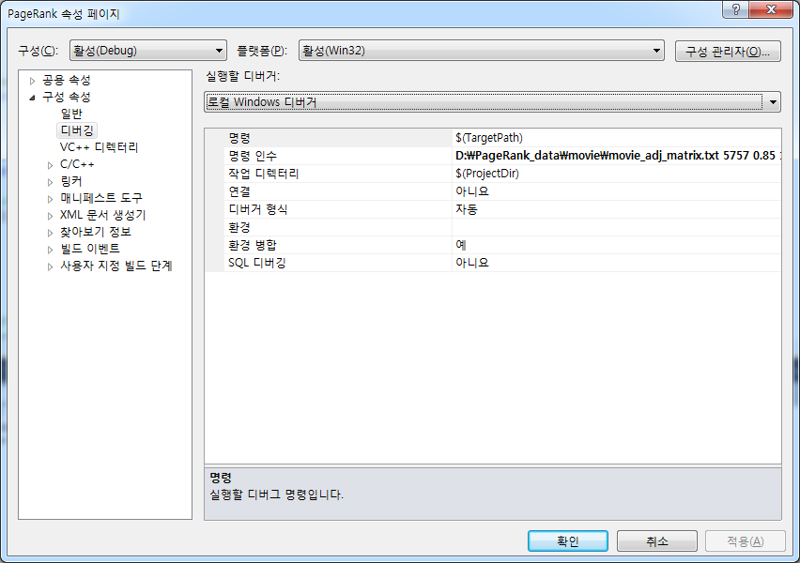
cf. Program argument setting for Visual Studio

Slide 31
Contents (Revisited)
PageRank
Introduction
Basic Idea
Random Surfer Model
Adjacency Matrix Implementation
Adjacency Matrix
Transition Probability Matrix
Vector-Matrix Multiplication
Inverse-Adjacency List Implementation
Motivation
Inverse Adjacency Lists
PageRank Calculation with IAL

Slide 32
pagerank_list.c
int main(int argc, char *argv[])
{
char* inputFile = argv[1];
int numPages = atoi(argv[2]);
double d = atof(argv[3]);
int numIteration = atoi(argv[4]);
double* vector = allocateVector(numPages, 1.0/numPages);
P_IALIST invAdjLists = loadInverseAdjacencyList(inputFile, numPages);
vector = calculatePageRank(vector, invAdjLists, numPages, d, numIteration);
return 0;
}

Slide 33
Motivation
0 1 2 3 4 5 6 7 8 9 10
0 1/11 1/11 1/11 … 1/11
1 0 0 1/1 0 0 0 0 0 0 0 0
2 0 1/1 0 0 0 0 0 0 0 0 0
3 1/2 1/2 0 0 0 0 0 0 0 0 0
4 0 1/3 0 1/3 0 1/3 0 0 0 0 0
5 0 1/2 0 0 1/2 0 0 0 0 0 0
6 0 1/2 0 0 1/2 0 0 0 0 0 0
7 0 1/2 0 0 1/2 0 0 0 0 0 0
8 0 1/2 0 0 1/2 0 0 0 0 0 0
9 0 0 0 0 1/1 0 0 0 0 0 0
10 0 0 0 0 1/1 0 0 0 0 0 0
1
2
5
0
4
10
3
9
6
7
8
Memory
Running Time O(i*n²)
→ O(i*o*n)

Slide 34
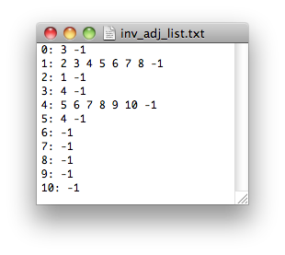
inv_adj_list.txt
1
2
5
0
4
10
3
9
6
7
8

Slide 35
inv_adj_list.txt
numOutlinks
*first
O
1
2
……
10
invAdjList[i].numOutlinks is the number of outlinks of page i
invAdjList[i].first points to the first inlink page in the linked list

Slide 36
inv_adj_list.txt
c_0 = 0
3
O
c_1 = 1
2
3
4
5
6
7
8
1
c_2 = 1
1
2
……
c_10 = 1
10
invAdjList[i].numOutlinks is the number of outlinks of page i
invAdjList[i].first points to the first inlink page in the linked list

Slide 37
Handling Pages with No Outlinks
c_0 = 11
0
3
O
1
2
5
c_1 = 1
0
2
3
4
5
6
7
8
0
1
4
10
c_2 = 1
0
1
2
3
9
6
7
8
……
c_10 = 1
0
10
If a page i has no outlinks, then generate ‘virtual’ outlinks to every page

Slide 38
PageRank Calculation with IAL
0 1 2 3 4 5 6 7 8 9 10
1 1 1 1 1 1 1 1 1 1 1
O
c_0 =11
0
3
1/11 + 1/2 = 0.6
c_1 = 1
0
2
3
4
5
6
7
8
0 1 2 3 4 5 6 7 8 9 10
1
.6
3.9
2
c_2 = 1
0
1
1
2
5
……
0
4
c_10 =1
0
10
10
3
9
6
7
8

Slide 39
Other operation
d *
0 1 2 3 4 5 6 7 8 9 10
.6
3.9
…
1
2
5
0
4
10
3
9
6
7
8

Slide 40
Other operation
d *
0 1 2 3 4 5 6 7 8 9 10
+ ( 1 – d ) * 1/|D|
.6
3.9
…
1
2
5
0
4
10
3
9
6
7
8

Slide 41
List Implementation: Summary
Load the inverse adjacency lists
Handling pages with no outlinks
Power Iteration

Slide 42

pagerank_list.c: Screen Shot

Slide 43
pagerank_list.c
int main(int argc, char *argv[])
{
char* inputFile = argv[1];
int numPages = atoi(argv[2]);
double d = atof(argv[3]);
int numIteration = atoi(argv[4]);
double* vector = allocateVector(numPages, 1.0/numPages);
P_IALIST invAdjLists = loadInverseAdjacencyList(inputFile, numPages);
vector = calculatePageRank(vector, invAdjLists, numPages, d, numIteration);
return 0;
}

Slide 44
Mini Project #2 (Revisited)
Dataset
wikipedia (adj_matrix, inv_adj_list) (11 web pages)
movie (node, adj_matrix, adj_list, inv_adj_list) (5757 web pages)
Source code
pagerank_matrix.c
Pagerank_list.c
Implementation
2 functions in pagerank_matrix.c
1 functions in pagerank_list.c
Report
Functions
Running time
Output files

Slide 45
Thank You

